Slide 1

Data Representation formats
JSON vs XML
Aruna S
Department of
Computer Science and Engineering

Slide 2

DATA REPRESENTATION FORMATS
JSON VS XML
S. Aruna
Department of Computer Science and Engineering

Slide 3
AJAX Techniques
XML - Constraints
XML documents must have a root element
XML elements must have a closing tag
XML tags are case sensitive
XML elements must be properly nested
XML attribute values must always be quoted
Valid XML is an XML document that has an associated document type declaration (DTD) and complies with the constraints expressed in it.

Slide 4
AJAX Techniques
XML - Advantages
XML is platform independent and programming language independent
XML supports unicode.
The data stored and transported using XML can be changed at any point of time without affecting the data presentation
XML allows validation using DTD and Schema.
XML simplifies data sharing between various systems because of its platform independent nature.

Slide 5
AJAX Techniques
XML - Disadvantages
It is difficult for the end-user to understand its capabilities.
XML syntax is redundant or large relative to binary representations of similar data, especially with tabular data.
The redundancy may affect application efficiency through higher storage, transmission and processing costs.
XML syntax is verbose, especially for human readers, relative to other alternative 'text-based' data transmission formats.
The hierarchical model for representation is limited in comparison to an object oriented graph.

Slide 6
AJAX Techniques
JSON
JSON (JavaScript Object Notation) is a lightweight data-interchange format
JSON code is valid JavaScript
JSON is a text format that is completely language independent
JSON is built on two structures:
A collection of name/value pairs
An ordered list of values
JSON file extension: *.json

Slide 7
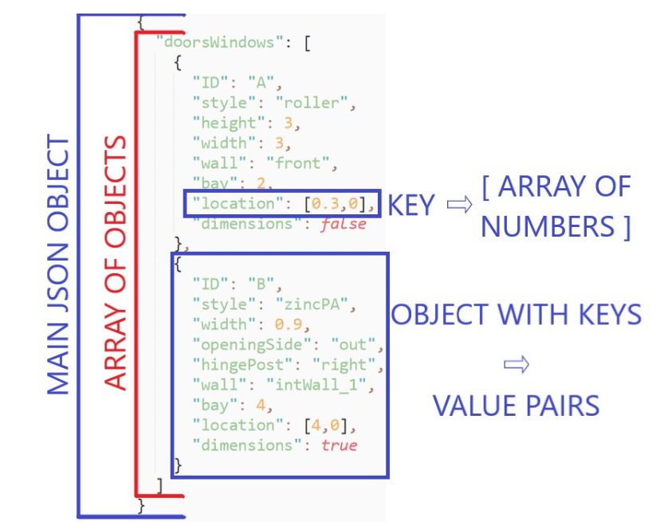
AJAX Techniques
JSON - Example

Slide 8
AJAX Techniques
Advantages of both JSON and XML
JSON is less verbose. Saves bandwidth compared to XML.
JSON is much easier to parse.
JSON is smaller but faster than XML
JSON can do cross domain calls.
XML is rendered very cleanly by most browsers
XML can be automatically converted into html without writing a single line of JS using XSL Stylesheets. JSON may need extensive js code to do this.
XML is well-suited to combining information sets from different systems.
XML is very robust method.

Slide 9
AJAX Techniques
Comparison Parameters
Human readability : JSON
json is less verbose
Speed : JSON
parsing
XML : slow ,large amt of memory
JSON : part of JS code, less time to parse
Security : XML
JS eval does not check the json code
code injection attack
Data interpretation : JSON
JSON : map like, easy
XML : tree like

Slide 10
THANK YOU
Aruna S
Department of
Computer Science and Engineering
arunas@pes.edu

